Slide 1

Balancing chemical equations

Slide 2

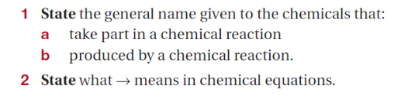
Chemical Equations
What is a chemical equation?
reactants
products
‘rearrange to form’

Slide 3
Chemical Equations
Word and formula equations
reactants → products
Word equation:
Magnesium metal + Lead nitrate solution → Magnesium nitrate solution + Lead metal
Write the formula equation:
Mg_{(s)} + Pb(NO₃)_{2(aq)} → Mg(NO₃)_{2(aq)} + Pb_{(s)}

Slide 4
Chemical Equations
Formula equation:
Mg _{(s)} + Zn(NO₃)₂ _{(aq)} → Mg(NO₃)₂ _{(aq)} + Zn _{(s)}
Write the word equation:
Magnesium metal + Zinc nitrate solution → Magnesium nitrate solution + zinc

Slide 5
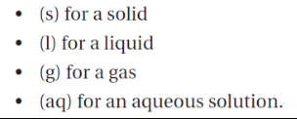
Chemical Equations
Showing states
Solid NaCl
NaCl dissolved in water

Slide 6
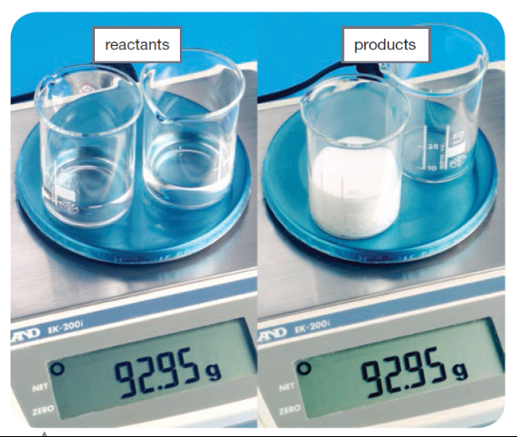


Slide 7
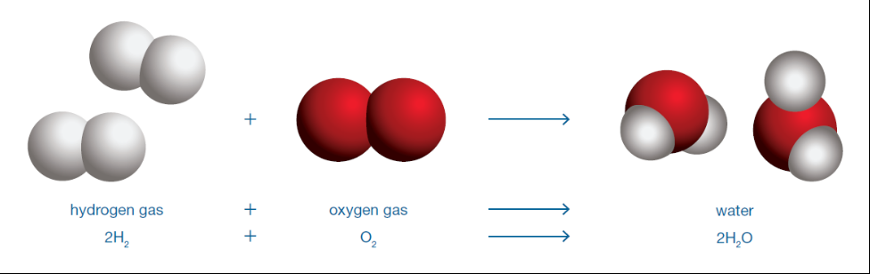


Chemical Equations
coefficient
subscript

Slide 8
Chemical Equations
Balancing chemical equations
Calcium metal (Ca) reacts with oxygen gas (O₂) to produce solid calcium oxide (CaO)
reactants → products
Write the word equation:
calcium + oxygen gas → calcium oxide
Write the formula equation:
Ca_{(s)} + O_{2(g)} → CaO_{(s)}

Slide 9
Write the formula equation:
Ca_{(s)} + O_{2(g)} → CaO_{(s)}
Do an atom count:
Ca = 1
O = 2
Ca = 1
O = 1
Is the equation balanced?
No, not enough oxygen on the product side

Slide 10
Chemical Equations
Add coefficients to balance the equation
2
Ca_{(s)} + O_{2(g)} → CaO_{(s)}
2
Ca = 1 2
O = 2
Ca = 1
O = 2
Ca = 1 2
O = 1 2
Ca = 1
O = 1
Double check the number of atoms on both sides of the equation balance

Slide 11
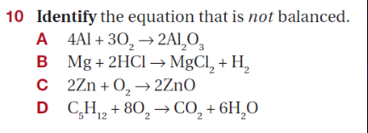
Practice Questions 1

Slide 12
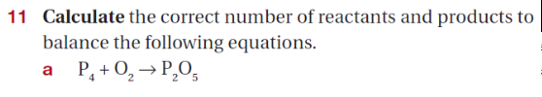
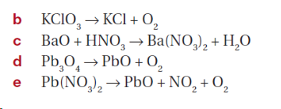
Practice Questions 2

Slide 13



Answers
Practice Questions 1
Practice Questions 2
a) P₄ + 5 O₂ → 2 P₂O₅
b) 2 KClO₃ → 2 KCl + 3 O₂
c) BaO + 2 HNO₃ → Ba(NO₃)₂ + H₂O
d) 2 Pb₃O₄ → 6 PbO + O₂
e) 2 Pb(NO₃)₂ → 2 PbO + 4 NO₂ + O₂

Slide 14
Need more practice?
On SEQTA and OneNote classroom there are three worksheets on balancing chemical equations with answers
Guiding videos (youtube) on the topic:
https://www.youtube.com/watch?v=yA3TZJ2em6g (intro to balancing equations)
https://www.youtube.com/watch?v=eNsVaUCzvLA (practice questions with worked answers)
Play a Phet game: https://phet.colorado.edu/en/simulation/balancing-chemical-equations

